Slide 1
How can we increase revenue
from
Catch the Pink Flamingo?
JULIAN HATWELL
Notes:
Title Slide:
Today’s presentation follows a 4 week data science project, using the data generated by Eglence’s Catch the Pink Flamingo Game. We’re specifically looking for insights that may help increase revenues from the game.

Slide 2
Problem Statement
How can we use the following data sets to understand options for increasing revenue from game players?
Data from the game:
Game performance – User game clicks and user strength
Team affiliations and progress – team membership and team level
Click data – Buy clicks and Ad clicks
Data from social chat:
Interactions among the users within each team
Notes:
Slide 1:
Data science is about finding the stories hidden inside the data. Some of the stories are obvious or easily intuited, and simply need validation or quantification. They need to be tested to determine if they’re significant or not. The job sometimes ends there.
Other stories are much trickier or more deeply hidden. Sometimes they come as a complete surprise. These are the most exciting stories to discover, not only because they can be fascinating in themselves. In business, such stories can provide unique insights that allow us to excite and delight our customers and outpace our competition. Through the ideas they generate, we can execute more effective marketing campaigns, truly ground breaking product innovation and elimination of unnecessary features and waste.
How do we find such stories?
Firstly, it’s always important to start with a very clear question, such as the one presented here:
“How can we use this data to increase revenues?”
Secondly, we want to use all the data we have available, no matter how Voluminous and no matter how Varied. Our data may also have a great Velocity, meaning that it’s changing fast, but we also need to capture that. By mixing and combining all our data from many different sources especially data that aren’t obviously connected to each other, we have the best chance to find completely novel insights that truly add Value.
For the Data Science project we’ve completed for Eglence, there were different sources of data.
Within the game, there are the users and their individual performance – how well they play the game
There’s also the team affiliations – who is a member of which team and how well are the teams doing
Thirdly, there is data relating to revenue – when users make in game purchases or click on our display ads
Outside of the game, we know there is a strong user community. Our game is talked about a lot. We provide a chat feature that allows members of a team to freely chat to each other about any topic they like (though we’re sure they’re usually discussing how to find the next Pink Flamingo).
This chat data can be linked to all the other data we have by the unique user and team ids and we can investigate how chat behaviour is connected to all the other information we have.

Slide 3
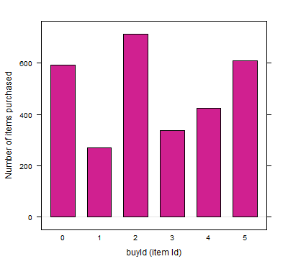
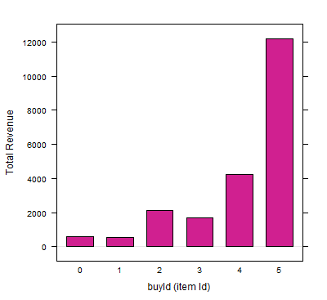
Data Exploration Overview
This is only the beginning!
Highest spending users:
Rank | User Id | Platform | Hit-Ratio (%)
1 | 2229 | iPhone | 11.6
2 | 12 | iPhone | 13
3 | 471 | iPhone | 14.5
Notes:
Slide 3:
With our main question in mind, the first step is to take the available data in its raw format and start exploring to see what’s there and become familiar with the structures and schema. The detail of all this can be found in the technical appendix so I won’t cover that here.
Instead I will show you a couple of charts that can be produced very quickly without much effort that already give us an idea that there are ways to increase revenue. The charts show us a big difference between number of items purchased in the game and the revenue generated by these items. Items 0 and 2 are the top first and third sellers but are generating hardly any revenue. How can we improve the profit margin here?
We also learned that the highest spending users all use iPhones and all have above average Hit Ratio in the game. What can we learn when we dig a little deeper?
This is the kind of thing we can discover after just a few minutes’ work. It’s exciting to think about what else there is to find!

Slide 4
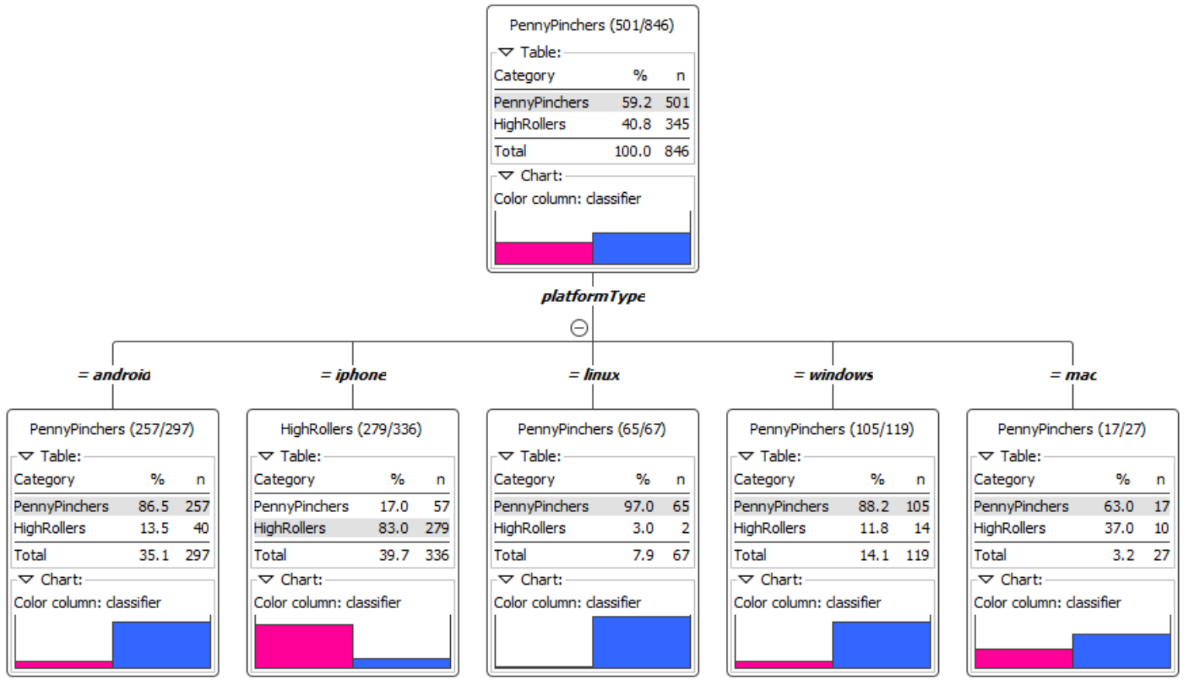
What have we learned from classification?
Users were classified as Big Spenders if they spent more than $5 total on in-app purchases.
It turns out that the tendency to be a Big Spender (in pink) is very closely associated with iPhone users
Notes:
Slide 4:
The classification analysis was done using a Decision Tree learner. This stage told just one very clear story; iPhone users are very likely to be Big Spenders, while users of other operating systems were very unlikely to be. This behaviour was so strong and reproducible that even running the algorithm multiple times, with many different settings gave no different answers.
The decision tree stats were unambiguous, and this high spending behaviour was predicted on new data with an accuracy of 88.5%

Slide 5
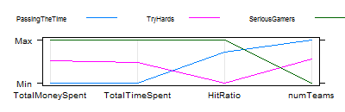
What have we learned from clustering?
After trying different values of K, 3 distinct and useful clusters were found. A visual representation is shown using scaled data for comparison:
Cluster | NickName | Cluster Center
1 | Passing The Time | TotalMoneySpent: 8.07, TotalTimeSpent: 4654, HitRatio: 0.1091 numTeams: 2.63
2 | Try Hards | TotalMoneySpent: 19.28, TotalTimeSpent: 14544, HitRatio: 0.1005, numTeams: 1.94
3 | Serious Gamers | TotalMoneySpent: 29.5, TotalTimeSpent: 25405, HitRatio: 0.1125, numTeams: 1.09
Notes:
Slide 5:
The clustering exercise was super interesting. It gave us an obvious result, which helps to validate the process and gave us some really unexpected results in other respects.
We validated the notion that users who spend more time in the game also tend to spend more money. This is to be expected as we think these are engaged users who want to compete and get ahead. Our top performing cluster in time and money spent, also have the best results. See cluster 3, the Serious Gamers.
The new insights discovered is that the users who are much less engaged in the game, spending the least time or money, are also changing from team to team more often. These users are not especially engaged and perhaps are being voted off teams that see them as a weak link. Another possibility is that they just haven’t found their rhythm in the game and a targeted marketing campaign offering help, tips and boosts could be a solution. A third possibility is that they’re interested in the social aspect of the game’s community and are changing teams as they get to know more people. This is open for further research.
The other new insight is that there is a cluster who are trying really hard. They are engaged and spend a lot of time and money in the game. They change teams on average only once from their original starting team. Yet the time and money they spend in the app is not helping them to get ahead with their progress. We deduce this because despite all the effort, their Hit Ratio in the lowest of the three clusters. They are trying hard but not succeeding! This is a great opportunity to reach out to these users and offer them new ways to improve their game, maybe by updating the boosts available to buy in the game or offering more paid for tips and clues!

Slide 6
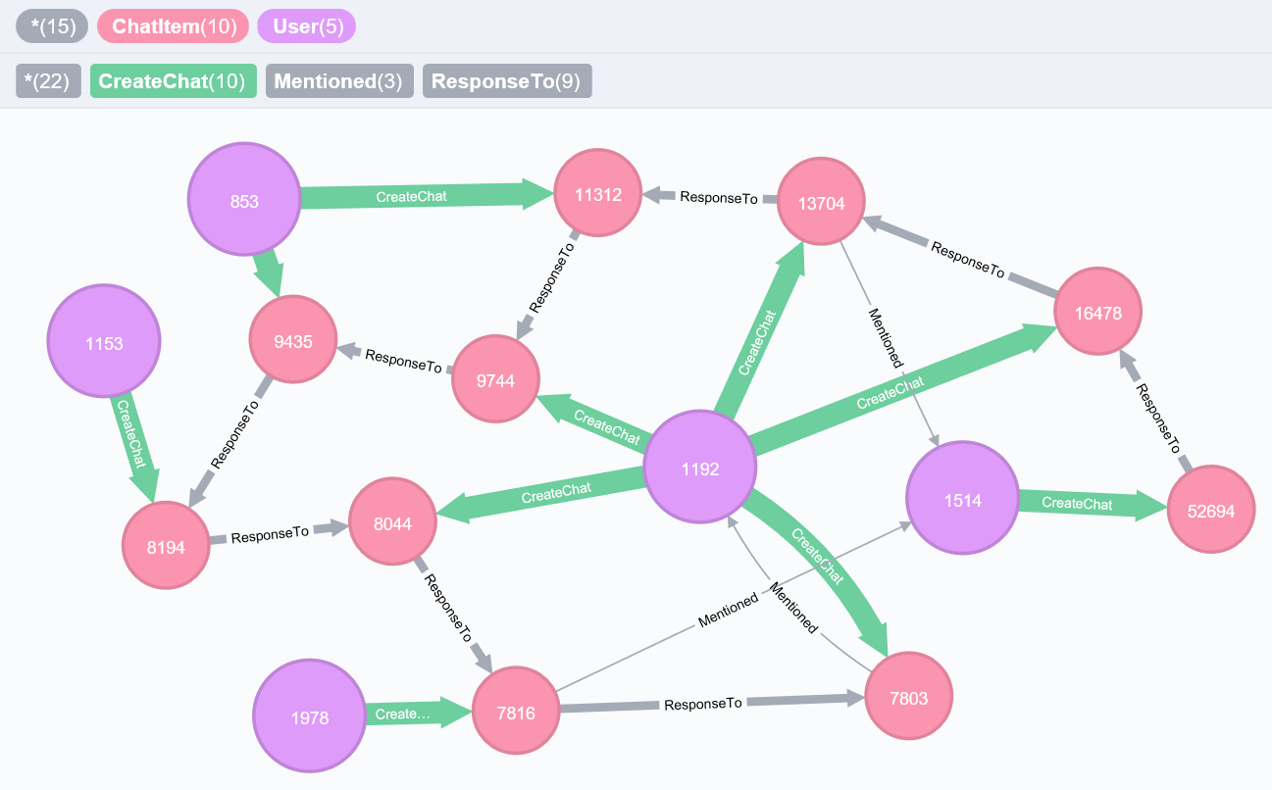
From our chat graph analysis, what further exploration should we undertake?
Next steps:
1. Link chat behavior to game clicks, buy clicks and ad clicks data.
Are the chattiest users also the ones spending time and money in the game?
2. Find the most connected users by number of teams joined and number of interactions with other users.
How can Eglence approach these users to spread marketing messages to other users?
Notes:
Slide 6:
Using Graph, Path and Connectivity Analytics, it has been possible to discover more about user behaviour in the chat and community features of the game. This helps reveal whether there is an overlap between the chattiest users and the chattiest teams.
The chat chain shown on the slide containing 10 chat items was the longest. We can see the users interacting with each other through mentions and responses.
Thinking about what further exploration we should undertake, the next steps could be to link user chattiness (which can be measured as the out degree of CreateChat edges from User nodes) to in game behaviours such as game clicks, hit ratio, buy click and add clicks.
We can also look at the Team chattiness, and the chattiness of Team member Users and if that has an effect on overall team strength.
Finally, and perhaps most importantly, we can look at the most well connected users (measured by out degree of interactions with other users) and try to target them with special incentives and marketing messages.

Slide 7
Recommendation
Step 1. Identify the users who fit our “ideal user” – they have the following characteristics:
iPhone user
spends a lot of time playing - though score or hit ratio is not important
doesn’t change teams
uses the chat features to co-ordinate play with other users
Step 2. Create incentives for them to purchase item Id 6
Notes:
Slide 7:
Putting together everything we’ve discovered, it’s possible to describe the ideal customer – they have the following characteristics:
iPhone user
spends a lot of time playing – a further split on their hit ratio is worth looking at
doesn’t change teams
uses the chat features to co-ordinate play with other users
These users are most likely to spend money in the game and may lead other users to play more via chat. We should identify these users and offer them incentives to buy item id 6. This buyable item has by far the highest profit margin and these users already show a predisposition to make in app purchases.
Those with low hit ratios may respond really well to paid for tips and clues.

